Slide 1


SRM INSTITUTE OF SCIENCE AND TECHNOLOGY SCHOOL OF COMPUTING
DEPARTMENT OF DATA SCIENCE AND BUSINESS SYSTEMS
18CSP107L- MINOR PROJECT
VEHICLE HEALTH ANALYSIS AND SPARE PARTS E-COMMERCE
Yuvraj Singh Chauhan- RA1911027010058
Avinash Reddy Vasipalli- RA1911027010007
Guide: Dr. T. Karthick
Designation: Assistant Professor, Department of Data Science and Business Systems

Slide 2
Table of contents
Abstract
Introduction
Existing System
Proposed System

Slide 3
Abstract
In many automobile industries, predictive maintenance has become more important. It is hard to diagnose failure in advance in the vehicle industry because of the limited availability of sensors and some of the designing exertions. However, it looks feasible today to analyze sensor’s data along with machine learning techniques for failure prediction.
the main objective is to determine the optimal allocation of spares for replacement of defective parts at a minimal total cost as possible by formulating a solution for the problems and providing the best solution that could rectify the problem.
Vehicle Health Analysis and spare parts E- commerce application aims to analyze the informations to estimate the total maintenance cost and insurance amount.
The system also suggests the insurance sum that could be received for the unforeseen circumstances such as bumper damage, engine hold etc.
The system is also expected to provide the e commerce support where in, if the issue is with carbonator then it provide the best available online - with the model in mind - carbonators that will solve it problem using NLP.

Slide 4

Introduction
The global e-commerce automotive aftermarket size was valued at USD 53.78 billion in 2020 and is expected to expand at a compound annual growth rate (CAGR) of 14.6 % from 2021 to 2028.
The rising need for people and independent retailers to access more affordable automotive parts for sale in the aftermarket offers an impetus to the market.
Vehicle systems are complex both in hardware and software so their maintenance is challenging.
Maintenance strategy being used in vehicle industry is normally reactive that results in reduction of lifetime of vehicle and also loss of money, thus predictive maintenance is required on this stage to overcome these issues.
This ongoing trend of pure-play retailers deploying e-commerce strategies is projected to fuel the growth of the market.

Slide 5
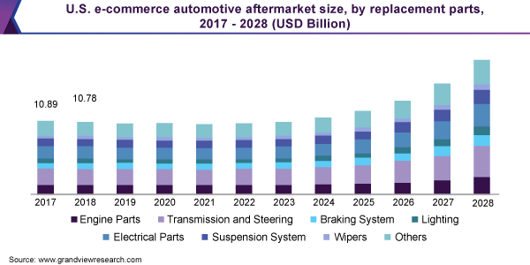

Slide 6
Existing Systems
Historically, technicians were called in order to assess the problems which the car has and they would suggest the estimated cost for fixing the issue as well.
In that system the chances of scamming the customers, not properly fixing the fault, not paying the insurance money to the customer due to lack of evidence and asking money way too much than the actual amount was common.
E-vehicle health monitoring and commerce systems were thus introduced to combat this problem from the market and provide a fair assessment for the problem at the best cost.
The current vehicle health monitoring systems uses ML algorithms to determine the condition of the vehicle and provide diagnosis for the same.
The replacement for the faulty parts is provided by the system at a minimum cost which is then installed by the technician.
If however the fault is there due to some unforeseen circumstances, diagnosis is done and the insurance money is paid to the customer.

Slide 7
Proposed Systems
It will analyze the information such as distance travelled since the time it is active, years used, model of car, and other factors to estimate the insurance amount to be paid and give maintenance alerts if required.
It will also give an option to the customer whether they like to order a technician to do the work or the customer themselves do it if they have the knowledge, however choosing the later will not give any warranty or free replacement if anything goes wrong.
It will also estimate the insurance claim that would be received by the customer due to faults caused by some unforeseen circumstances.
The system will also provide e-commerce support where in, if the issue is with a particular part then that particular part will be searched online and displayed to the customer by using the NLP model.

Slide 8
Thank You

